Slide 1
Attitude,
Adaptability & Flexibility
Sayli S. Bapat
Assistant Professor, Department of Management, Tilak Maharashtra Vidyapeeth

Slide 2
Definition and meaning
A feeling or opinion about something or someone or a way of behaving that is caused by this
Attitude can be altered since it is an opinion.
Attitude may be based on certain pre-conceived notions or first impressions of people, places, things and events. Hence it is possible to change it on the basis of evidence.
It can be seen through one’s speech and body language.

Slide 3
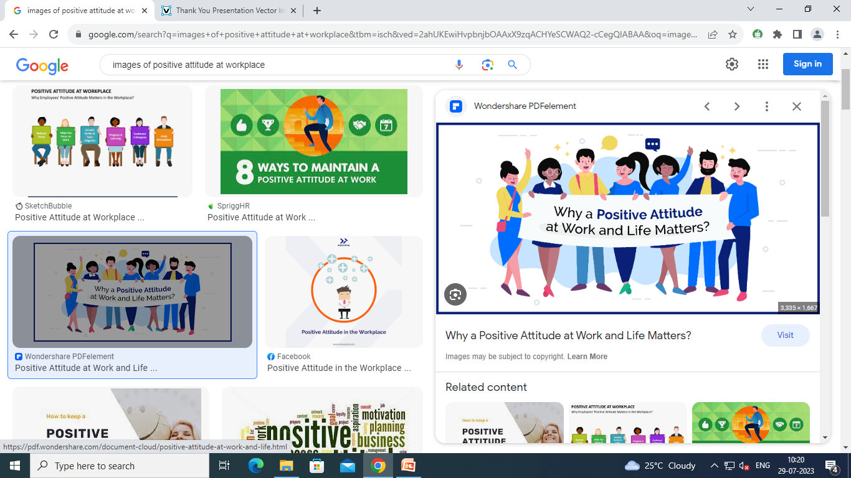
Positive attitude
Positive attitude results in positive behaviour and negative attitude will result in negative behaviour.
One cannot have control over all the events in our life but we can control the way we react to them.

Slide 4
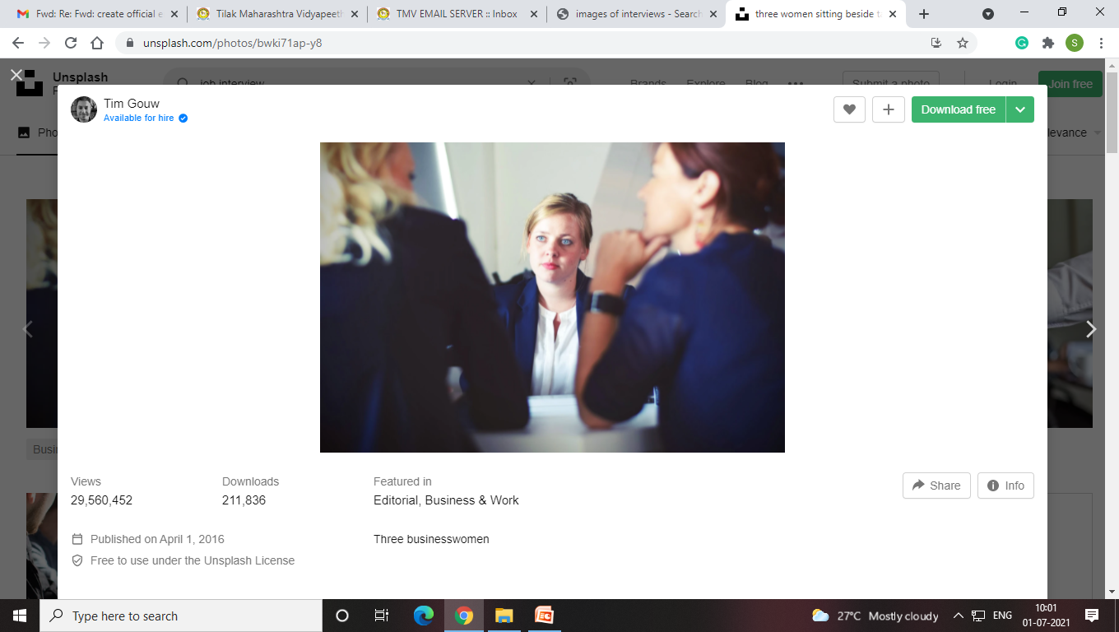
Examples of negative attitude
Attitude: I am scare of Job interviews
Resultant Behaviour: You get nervous, you shiver and get tongue-tied during interviews.
Attitude: I hate talking to strangers.
Resultant behaviour: You avoid meeting new people and your relationships at workplace suffer.

Slide 5
Positive and Negative talk
Negative Talk...
I am not smart
This isn’t fair
Things are not going my way
No one gives me any kind of importance
I am not good at this
Positive Talk...
I will not give up
This is possible
I will try my best
I will make a lot of friends
I am fine
Let us do it together

Slide 6
Power of Positive talk
We experience pleasant and happy feelings
We can develop positive attitude through positive self talk
Self-talk is your inner voice
Positive self-talk is an optimistic voice that always looks on the brighter side of things.
Practice positive self-talk every single moment and wipe off any negative thoughts that come to your mind.

Slide 7
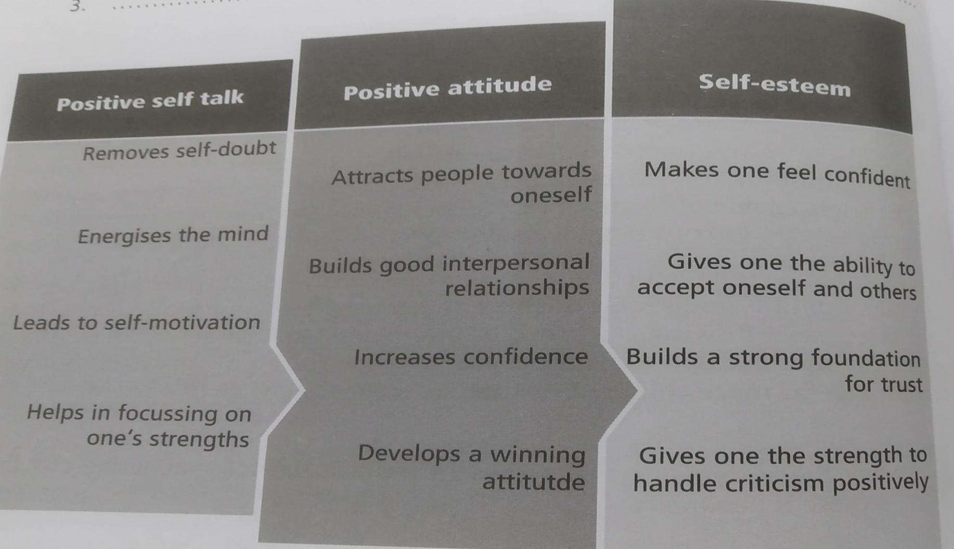
Self-talk, Attitude and Esteem

Slide 8
Self Esteem
Self Esteem is a state of mind
It is the way we feel and think about ourselves
It indicates confidence, worthiness and positive regard for oneself.
Good self esteem – Warmth and affection for others, inspire others, are not held back by fears and insecurities.
Self-esteem can be developed at any point in life.

Slide 9
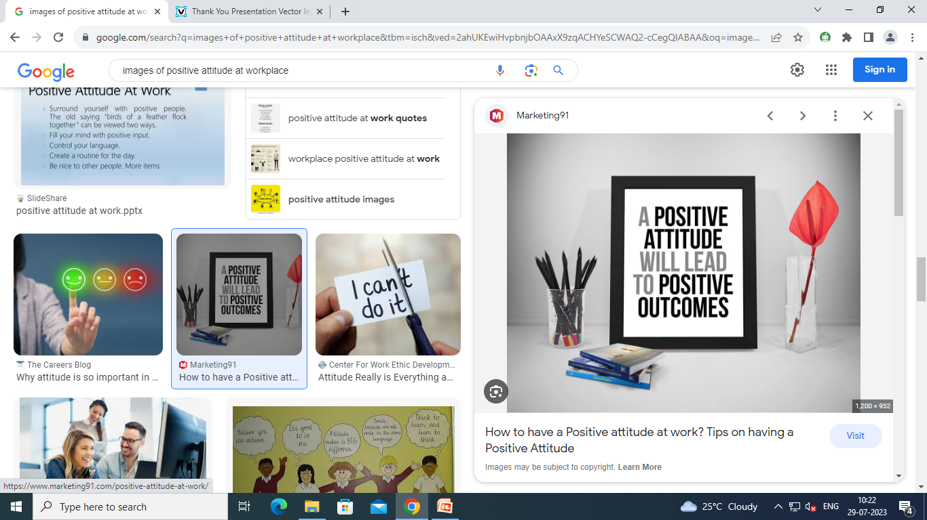
Attitude at workplace
Accepting a better idea
Accepting harsh criticism
Unlearning and re-learning
Moving out of comfort zones

Slide 10
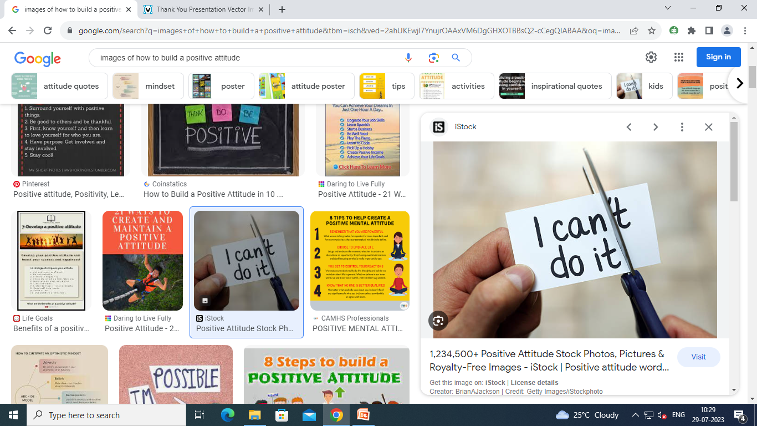
Building a positive attitude
Take good care of yourself. Do not stress yourself. It is difficult to think positive when you are mentally exhausted.
Stop and appreciate the good things you are blessed with in life. Learn to be grateful for them.

Slide 11
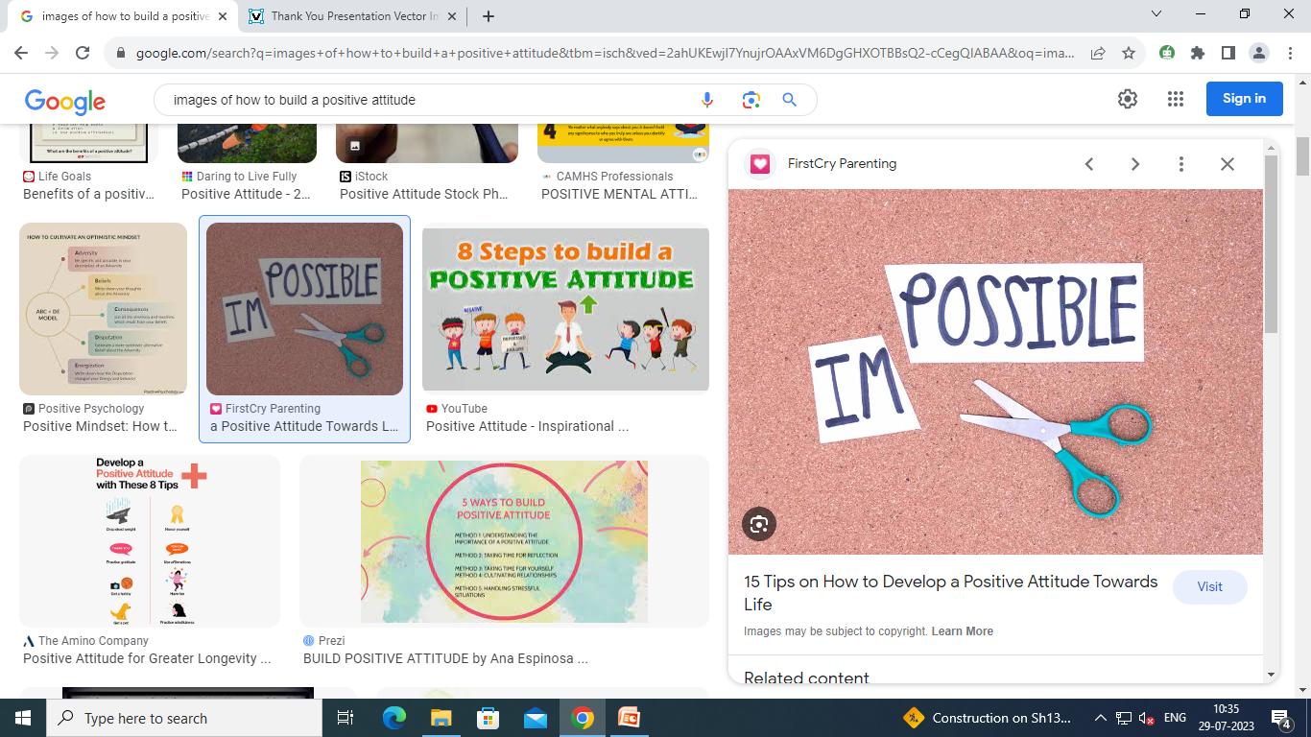
Building a positive attitude contd…
Look for proof instead of assumptions about people and situations.
Speak openly to people and understand their thoughts.
Get into the practice of throwing out negative thoughts and replacing them with positive ones.
Surround yourself with happy people. Their positive energy will affect you in a positive way.

Slide 12
Adaptability – One’s willingness to change
Look around and seize new opportunities
Obtain enriching feedback
Be ready to learn
Try doing things differently
Try to unlearn and relearn
Adaptability is needed for survival
Adaptability begins where flexibility ends

Slide 13
Flexibility – Changing oneself as per situational sensitivity
Flexibility involves thinking on the feet about the fit.
Flexibility is needed for growth.
It means ability and willingness to embrace new tasks and new challenges calmly without making a fuss.
It involves helping wherever and whenever needed and take on extra responsibilities willingly.
Flexible people are the most wanted people due to their never saying no for an answer and their positivity is appreciated.
Flexible nature shows confidence.

Slide 14
Importance of Adaptability and Flexibility
They are tied to career growth as a person becomes more equipped.
Better chances at job because employers are shifting from single role to multiple roles to rotation of roles and flexible job descriptions.
It helps a person to work and perform better under pressure and stressful situations.
You become a better team player when you acknowledge the views of others.

Slide 15
